Slide 1
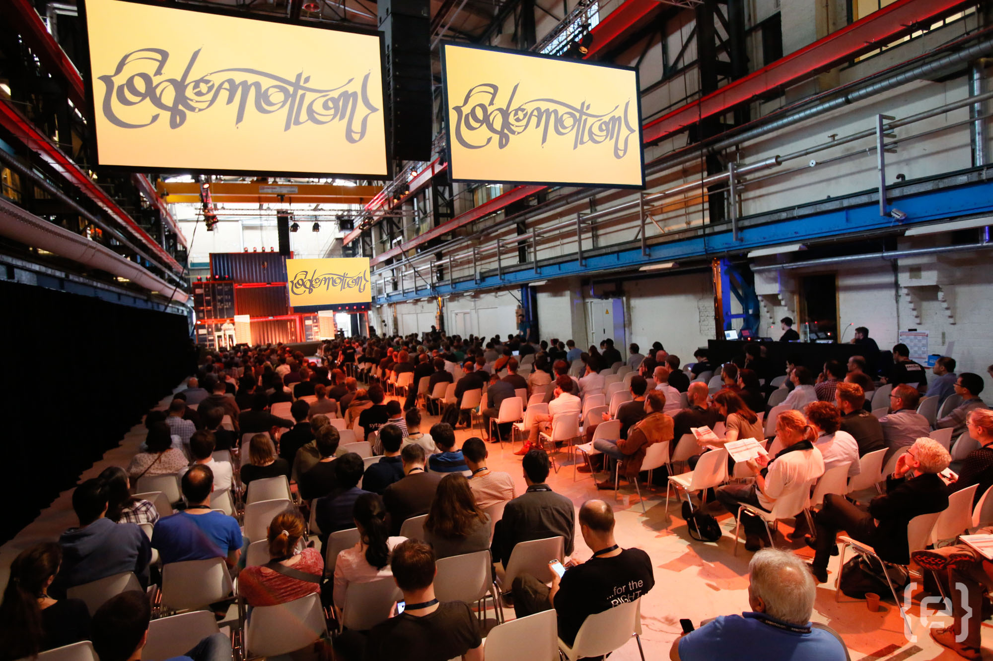
WEBINARS
Notes:
welcome to this webinar that is part of Codemotion
Codemotion is the multichannel platform that helps developers in their professional growth

Slide 2
is the biggest tech conference for developers in EMEA, open to all languages and technologies.
Notes:
Codemotion is the biggest tech conference for developers in EMEA, open to all languages and technologies.
It also organizes many events for developers, such as tech meetups, webinars, hackathons and training courses

Slide 3


Discover Realm: a new and powerfull Mobile Database
June, 11th, 2019
WEBINARS
Stefano Del Furia – Director of Digital Innovation
Campus DaVinci – Umbertide (PG)

Slide 5




What is Realm
Mobile Database
Offline-first
fast
Cross platform
Safe
Mobile Platform
auto migration
Easy of use
Reactive architecture
syncronization
thread safe
open source
Strong community
data push

Slide 6
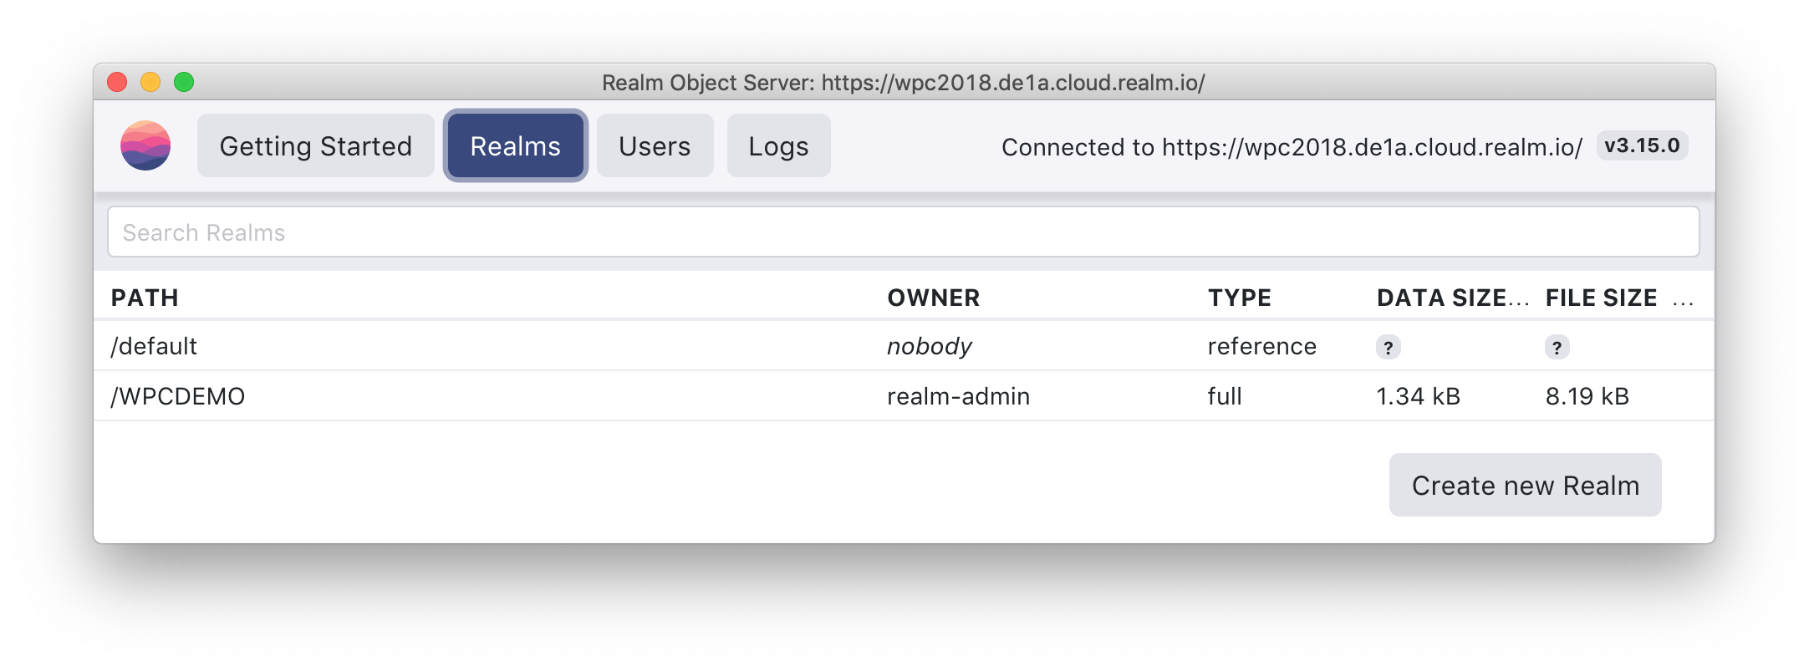
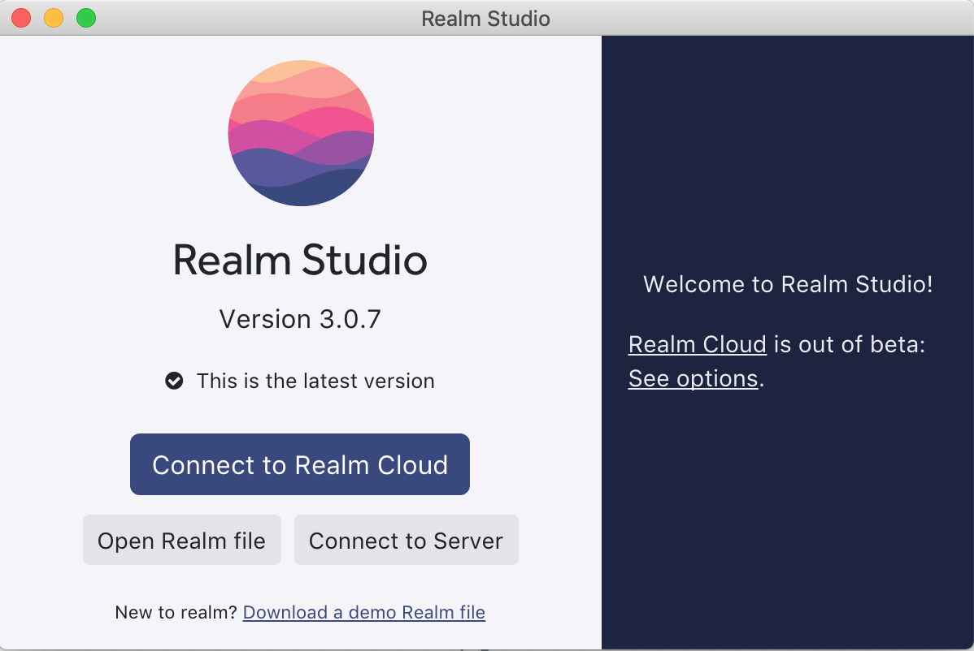
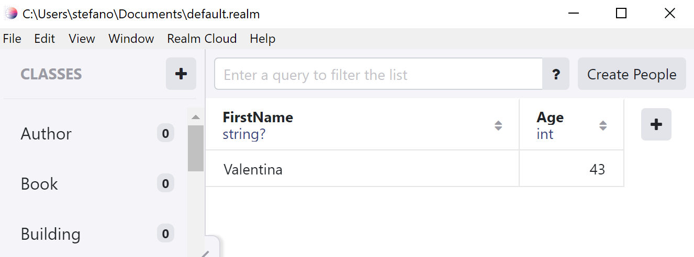
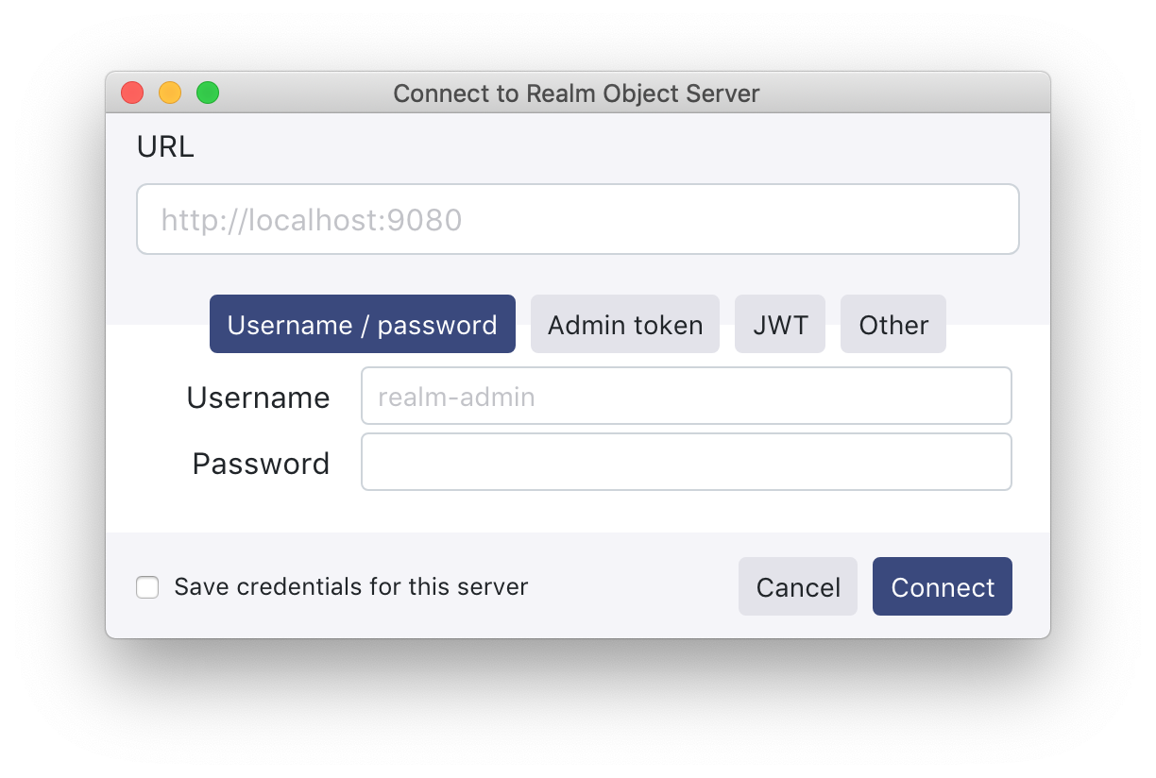
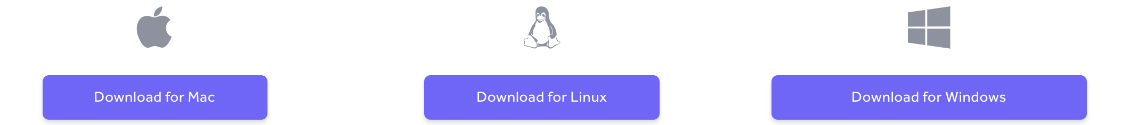
Realm Studio

Slide 7
What is not Realm
a relational database
a No-SQL database
an ORM

Slide 8
What is it ?
C++
B+ trees
Bit-packing
Column-oriented
Memory-mapped files
Cross-platform
Queries > writes (no-sql)
Small size
Fast Read/write
Zero-copy

Slide 9
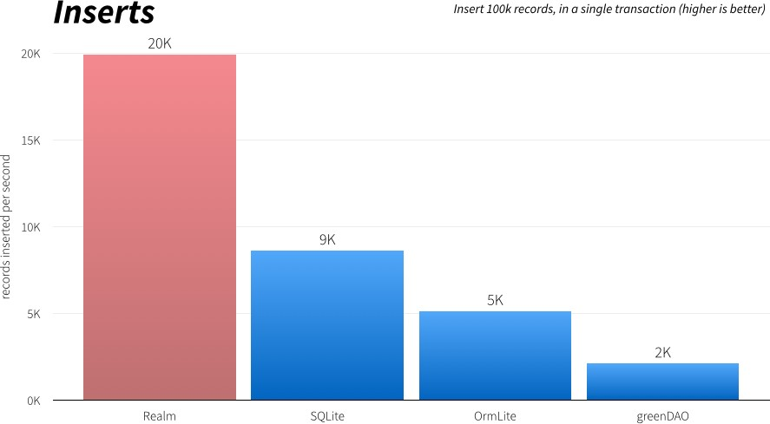
Speed !!!

Slide 10
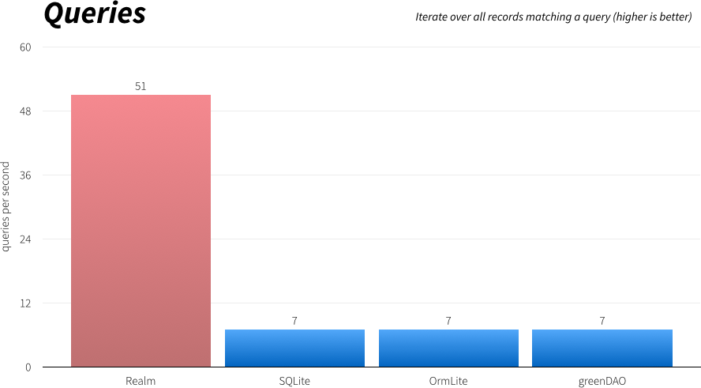
Speed !!!

Slide 11
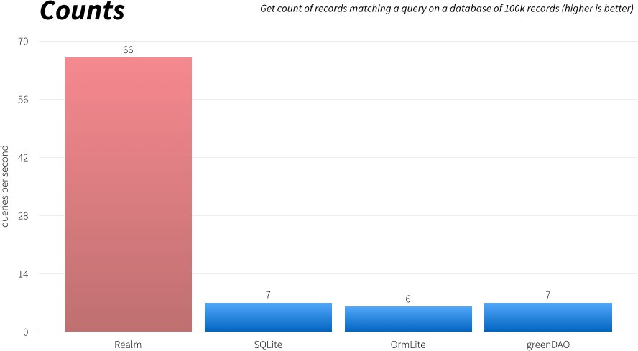
Speed !!!

Slide 12
The problem with “traditional” Database
What we do when we use a «normal» database
Create SQL Query
Connect to DB
Execute query
Read some datas
Object creation in Memory
Return the objects

Slide 13
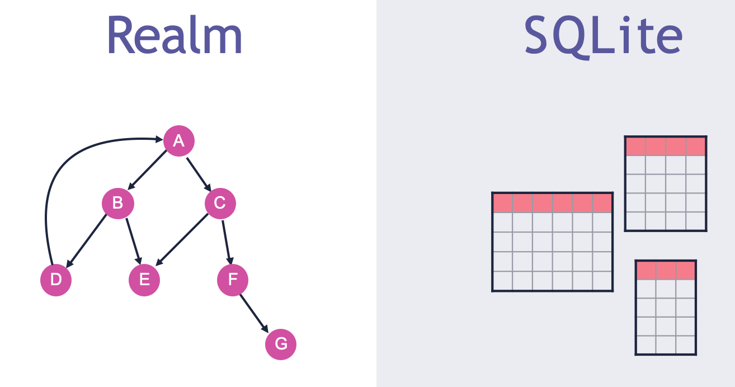
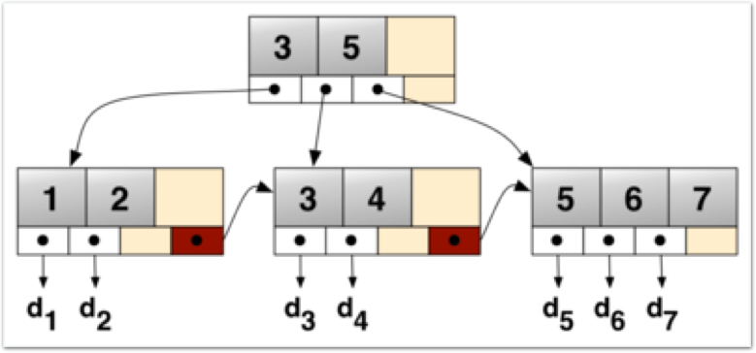
Why Realm is so fast: B+ tree
The primary value of a B+ tree is in storing data for efficient retrieval in a block-oriented storage context in particular, filesystems (NTFS, EXT4, Oracle …)

Slide 14
Why Realm is so fast : Memory Mapped File
Stack
Mapped file
Heap
Data
Text
Pointer
File

Slide 15
Zero-Copy
Only one entry point
RealmResults ~= Typed Cursor
Memory Efficient
Don’t need "LIMIT" or pagination
Lazy loading

Slide 16
Zero-Copy
No JOIN
No impedence-mismatch between relational and object model
No ID
Very fast Object navigation (like reference)

Slide 17
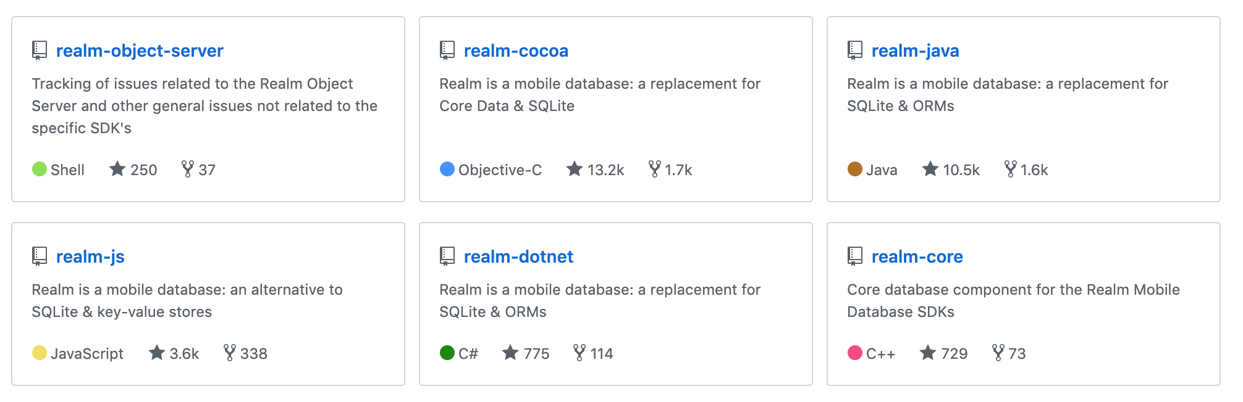
Realm everywhere !!!

Slide 18


Slide 19


Slide 20
Realm .NET
Xamarin.iOS ver iOS 7 or greater
Xamarin.Android API level 10 or greater
Xamarin.Mac macOS 10.11 or greater
.NET Framework 4.6.1 or greater for Windows 8.1 or greater
UWP App .NET Standard 1.4 or greater
.NET Core 1.1 or greater on:
Ubuntu 16.04 or greater
Debian 8 or greater
RHEL 7.1 or greater
macOS 10.11 or greater
Windows 10 or greater

Slide 21
Using Realm (C#)
Default Instance
var realm = Realm.GetInstance();
Get the default instance and map it in a file named default.realm in the Environment.SpecialFolder.Personal

Slide 22
Using Realm (Java)
// Initialize Realm (just once per application)
Realm.init(context);
// Get a Realm instance for this thread
Realm realm = Realm.getDefaultInstance();

Slide 23
Configure Realm
Custom Instance
Change the whole path (relative or absolute)
Change Realm’s file name with a custom name
var config = new RealmConfiguration("MyDb.realm");
var myRealm = Realm.GetInstance(config);

Slide 24
Configure Realm
In-memory Instance
With InMemoryConfiguration we are able to create Realm who aren’t persisted on the file system but «live» only in memory
var config = new InMemoryConfiguration("InMemoryDB");
var realm = Realm.GetInstance(config);

Slide 25
Data Manipolation
All classes derive from RealmObject (no POxO)
Available type: bool, char, byte, short, int, long, float, double, string, DateTimeOffset
Nullable

Slide 26
Data Manipolation
Only automatic properties are persisted
No Inheritance
No autoincremented fields

Slide 27
public class People : RealmObject
{
public string FirstName { get; set; }
public int Age { get; set; }
}

Slide 28
public class Dog extends RealmObject
{
private String name;
private int age;
// ... Generated getters and setters ...
}

Slide 29
«Special» attributes
[MapTo("Person")]
public class Employee : RealmObject
{
[PrimaryKey]
public string EmployeeID { get; set; }
[Required]
public string Name { get; set; }
[Ignored]
public Byte[] Photo { get; set; }
[Indexed]
public DateTimeOffset BirthDate { get; set; }

Slide 30
«Special» attributes
public string Email
{
get { return _email ?? "NA"; }
set { _email = value; }
}
[MapTo("Email")]
private string _email { get; set; }
}

Slide 31
Environment Setup
Install-Package Realm -Version 3.3.0
FodyWeaver.xml (manually with Nuget >= 3.1)
<?xml version="1.0" encoding="utf-8" ?>
<Weavers>
<RealmWeaver />
</Weavers>
Gradle Plug-in in Java & Android Studio

Slide 32
Update only inside Transactions (C#)
People man = new People() { FirstName = "Stefano", Age = 52 };
realm.Write(() => realm.Add(man));
People woman = new People() { FirstName = "Vale", Age = 43 };
using (var trans = realm.BeginWrite())
{
realm.Add(woman);
trans.Commit();
}

Slide 33
Update only inside Transactions (C#)
using (var trans = realm.BeginWrite())
{
woman.FirstName = "Valentina";
trans.Commit();
}
using (var trans = realm.BeginWrite())
{
realm.Remove(man);
trans.Commit();
}

Slide 34
Update only inside Transactions (Java)
// Persist your data in a transaction
realm.beginTransaction();
final Dog managedDog = realm.copyToRealm(dog);
// Persist unmanaged objects
Person person = realm.createObject(Person.class);
// Create managed objects directly person.getDogs().add(managedDog); realm.commitTransaction();

Slide 35
Realm 101
Demo1

Slide 36
Configure Realm
Realm persists (by default) all classes that derive fron RealmObject
(The model is the schema)
You can choose which class to pesist
var config = new RealmConfiguration("RealmWithOneClass.realm");
config.ObjectClasses = new[] { typeof(People) };
var realm = Realm.GetInstance(config);

Slide 37
Custom Config
Demo2

Slide 38
Database Query
"Linq to Realm"
Not-supported operators
GroupBy
Distinct, Union, Intersect, Except
LongCount, Sum, Min, Max, Average
Take, Skip, TakeWhile, SkipWhile
SelectMany
Concat
Join , GroupJoin

Slide 39
Database Query
var all = realm.All<People>();
var allDynamic = realm.All("People");
var more50 = realm.All<People>().Where(p => p.Age > 50);
var more50OrderByAge = realm.All<People>()
.Where(p => p.Age > 50)
.OrderBy(p=>p.Age);
People myFriend = realm.where(People.class).equalTo("age", 50).findFirst();

Slide 40
Query
Demo3

Slide 41
Relations
Reference a single object (1-1)
IList<T>, for (1-N o N-N) relations
IQueryable<T>, when we want to process objects retrived by a query

Slide 42
1 – 1 Relations
public class Building : RealmObject
{
public string Address { get; set; }
public Family Owner { get; set; }
}
public class Family : RealmObject
{
public string LastName { get; set; }
public Building House { get; set; }
}

Slide 43
Family df = new Family() { LastName = "Del Furia" };
Building h1 = new Building() { Address = "P. Matteotti" };
df.House = h1;
h1.Owner = df;
realm.Write(() =>
{
realm.Add(df);
realm.Add(h1);
});

Slide 44
Watch out to references ☹
Family br = new Family() { LastName = "Falucca" };
Building h1 = new Building() { Address = "Corso Italia" };
br.House = h1;
realm.Write(() =>
{
realm.Add(df);
realm.Add(h1);
});

Slide 45
1-1 Relations
Demo4

Slide 46
1 – N Relations
public class Book : RealmObject
{
public string Title { get; set; }
public Author Author { get; set; }
}
public class Author : RealmObject
{
public string Name { get; set; }
public IList<Book> Books { get; }
}

Slide 47
Author df = new Author() { Name = "DelFuria" };
Book b1 = new Book() { Title = "Programming C#" };
Book b2 = new Book() { Title = "Realm DB" };
df.Books.Add(b1);
df.Books.Add(b2);
b1.Author = df;
b2.Author = df;
realm.Write(() =>
{
realm.Add(df);
realm.Add(b1);
realm.Add(b2);
});

Slide 48
Watch out to references ☹
Author fr = new Author() { Name = "Roberto" };
Book b3 = new Book() { Title = ".NET" };
fr.Books.Add(b3);
// the author’s reference is unassigned..
realm.Write(() =>
{
realm.Add(fr);
realm.Add(b3);
});

Slide 49
1-N Relations
Demo5

Slide 50
The Solution: BackLink
public class Ship : RealmObject
{
public string Name { get; set; }
public Captain Captain { get; set; }
}
public class Captain : RealmObject
{
public string FirstName { get; set; }
[Backlink(nameof(Ship.Captain))]
public IQueryable<Ship> Ships { get; }
}
// Equivalente al BackLink
public IQueryable<Ship> Ships
{
get
{
return this.Realm.All<Ship>()
.Where(s => s.Captain.Equals(this));
}
}

Slide 51
Captain fr = new Captain() { FirstName = "Roby" };
Ship ship3 = new Ship() { Name = "Child" };
ship3.Captain = fr;
realm.Write(() =>
{
realm.Add(fr);
realm.Add(s3);
});

Slide 52
1-N Relations with backlink
Demo6

Slide 53
Multithreading
Access limited to 1 process only
Multithread available
Object don’t cross thread “borders”
var person = new People() { FirstName = "Riccardo" };
...
var referencePerson = ThreadSafeReference.Create(person);
var anotherPerson = altroRealm.ResolveReference(referencePerson);
// now i can write in another thread
anotherRealm.Write(() =>
{
anotherPerson.FirstName = "Marco";
});

Slide 54
MultiThread
Demo8

Slide 55
Cryptography
AES 256
SHA-2
64 Bytes key
string key =
"This is a 64Bytes key, just like Realm wants and not a char less";
config.EncryptionKey = Encoding.ASCII.GetBytes(key);
Warning !!! Irreversible

Slide 56
Cryptography
Demo7

Slide 57
Migration
Version management
Custom code executed within Callback Function
Properties “Dynamic” access (if you have deleted it)

Slide 58
var config = new RealmConfiguration("Demo2CustomConfig.realm")
{
SchemaVersion = 2,
MigrationCallback = (migration, oldSchemaVersion) =>
{
var newPeople = migration.NewRealm.All<People>();
// Use dynamic API for oldPeople and accessing Age
var oldPeople = migration.OldRealm.All("People");
for (var i = 0; i < newPeople.Count(); i++)
{
var oldPerson = oldPeople.ElementAt(i);
var newPerson = newPeople.ElementAt(i);
newPerson.BirthYear = 2018 –(int)oldPerson.Age;
}
}
};

Slide 59
Migration
Demo2Migrations

Slide 60
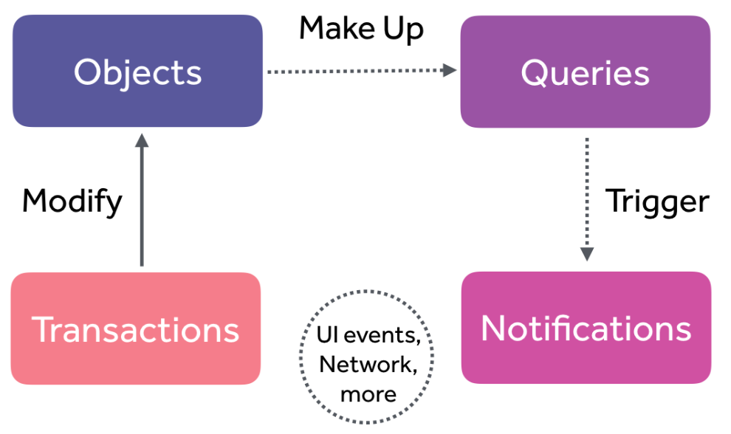
Notification

Slide 61
Notification
Realm notification (useless)
realm.RealmChanged += (s, e) => { }
Object notification - Implements INotifyPropertyChanged
var account = new Account();
realm.Write(() => realm.Add(account));
account.PropertyChanged += (sender, e) =>
{// react to properties change }
Collection notification – Implements INotifyCollectionChanged
var token = realm.All<Person>().SubscribeForNotifications ((sender, changes, error) =>
{ // Insert, Delete and change notifications});
When you want to stop receiving notifications
token.Dispose();

Slide 62
Realm + Binding & MVVM
Available using
INotifyPropertyChanged
INotifyCollectionChanged

Slide 63
Binding - MVVM & Xamarin.Forms
XamarinForms_CRUD
XamarinForms_MVVM

Slide 64
Realm Mobile Platform
Realm Database
Realm Object Server

Slide 65
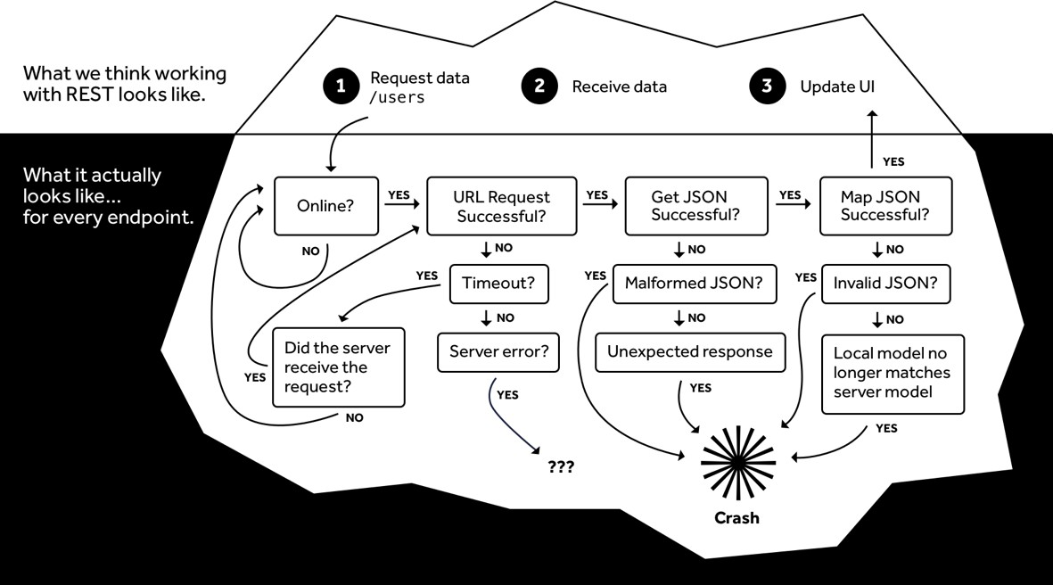
Scary Iceberg

Slide 66
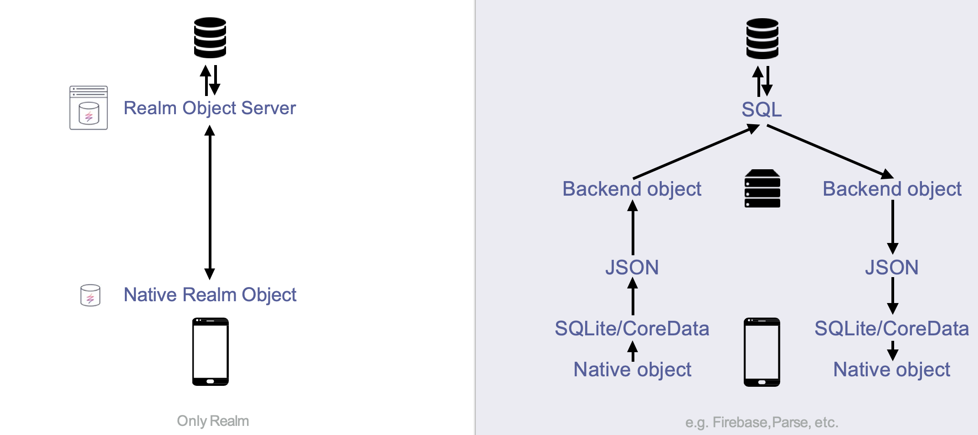
Remove useless things

Slide 67
Realm Object Server

Slide 68
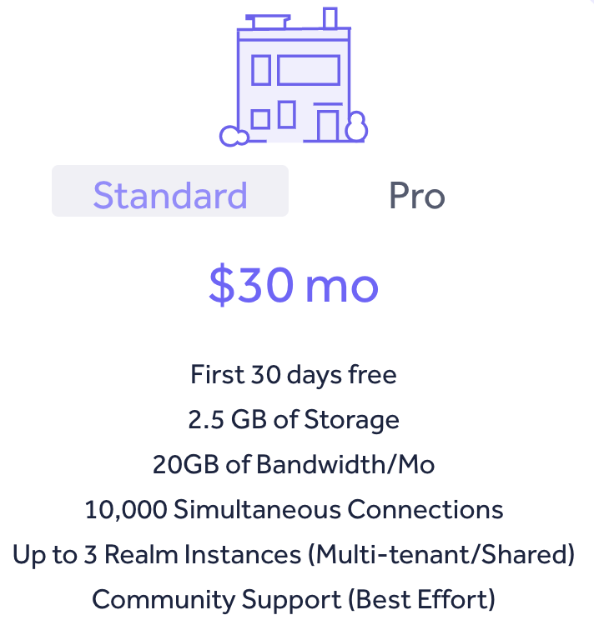
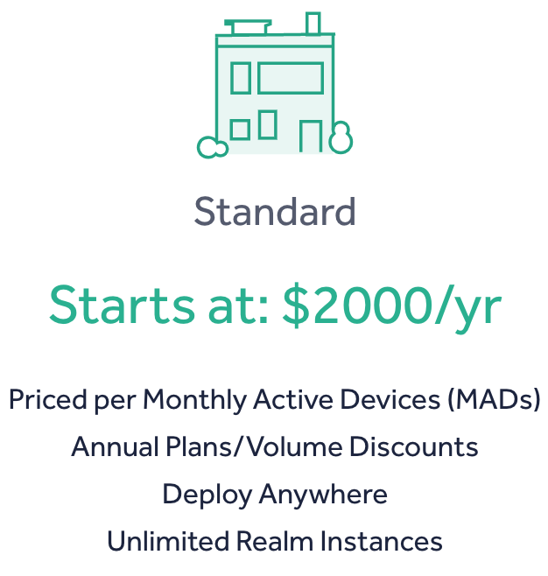
Realm Object Server: Cloud - OnPremise

Slide 69
Sync in action
var authURL = new Uri("https://codemotion.de1a.cloud.realm.io");
var credentials = Credentials.UsernamePassword("code", "motion", false);
var user = await User.LoginAsync(credentials, authURL);
var config = new SyncConfiguration(user, new Uri($"realms://codemotion.de1a.cloud.realm/Demo"))
{
ObjectClasses = new[] { typeof(Task), typeof(TaskList), typeof(TaskListList) }
};
var realm = Realm.GetInstance(config);
...
...

Slide 70
Syncronization
XamarinForms_SyncTask

Slide 71
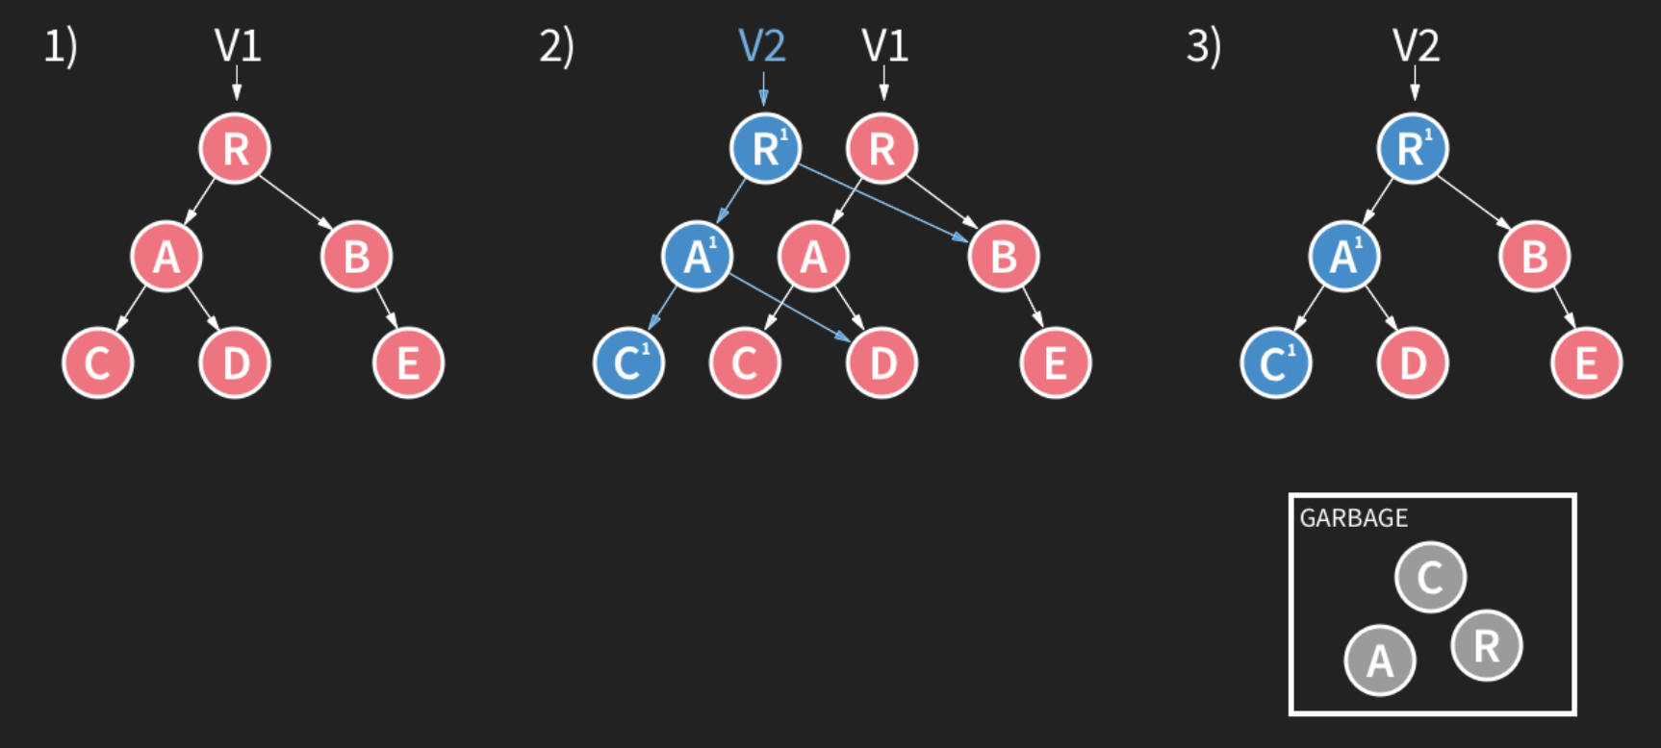
Concurrency Management
Multiversion concurrency control
Multiple read transactions
Data is versioned
One write transaction

Slide 72
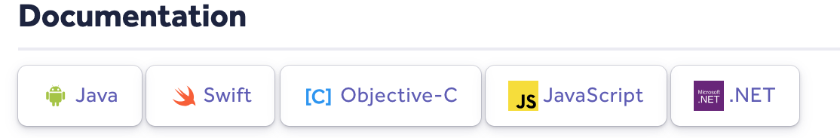
Links
Realm https://realm.io
Realm Mobile Platform https://docs.realm.io/platform/
Documentations about Realm https://realm.io/docs

Slide 73
Some more links
Realm Academy https://academy.realm.io https://academy.realm.io/posts/realm-world-tour-2017-eric-maxwell/
Demos https://github.com/delfuria/CodeMotion-Realm

Slide 74
NEXT CONFERENCES
CODEMOTION MADRID: September 24-25
CODEMOTION MILAN: October 24-25
CODEMOTION BERLIN: November 12-13
CODEMOTION AMSTERDAM 2020
Notes:
General message:
We are just to the and i would like to remember you the next conferences if you want to visit us

Slide 75
VISIT OUR PLATFORM CODEMOTION.COM
Notes:
General Message:
a few months ago we launched our online platform
where you can find articles, videos of events, interviews and even webinars

Slide 76
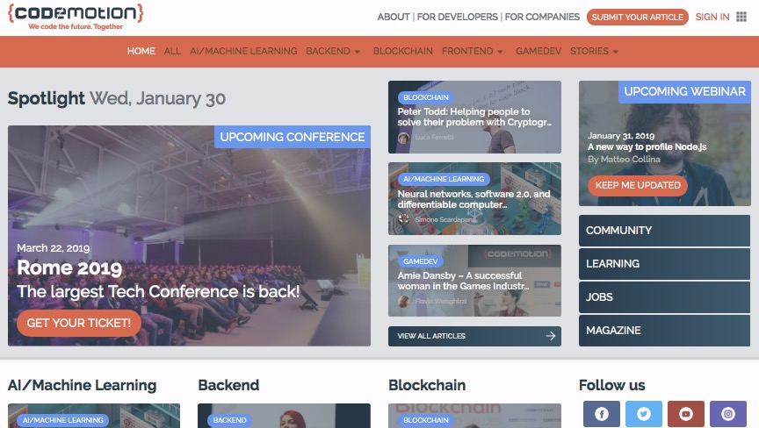

Slide 77
June, 11th, 2019
Please tweet your comments
#realm #codemotionwebinar
Twitter: @stenodelfo
Linkedin: /in/delfuria
delfuria@gmail.com
Stefano Del Furia Director of Digital Innovation & Teacher - Campus “Da Vinci”
Umbertide (PG) - Italy
Discover REALM !!!
Thank You Very Much ☺️ !

